Slide 1
HEALTHIFY ME
REVOLUTIONIZING NUTRITION: PERSONALIZED, ENGAGING, AND EMOTIONALLY INTELLIGENT DIET SOLUTIONS

Slide 2
1. ASWINI M S 2. ASWIN KRISHNA C P 3. NITHYA SHREE G 4. YESWANTH S
TEAM ELITERS

Slide 3
Develop a health platform where users input dietary restrictions and allergies to receive customized recipes. Users can join a supportive community, form health groups for competitions, access nutritional info and diet plans, and attend expert-led webinars. Empower individuals with tailored support and resources to achieve their health goals.
PROBLEM STATEMENT

Slide 4
1. Track your daily food intake, calories, and essential nutrients for better nutrition management. 2. Customizable meal plans based on dietary preferences, restrictions, and health goals. 3. Alerts to remind users to eat, drink water, and log meals. 4. Tools for monitoring weight, calories consumed vs. burned, and overall progress towards health goals with visual charts and graphs. 5. Barcode scanning for quick and accurate logging of food intake.
EXISTING SOLUTION

Slide 5
1. Suggest safe and tasty food options based on the user's allergies and dietary restrictions. 2. Promote teamwork and motivation with fun family challenges and friendly competitions. 3. Offer recipes that match the user's current mood and preferences for a better eating experience. 4. Create diet plans tailored to individual health needs, using insights from DNA, gut bacteria, and expert advice to ensure optimal nutrition and health management.
PROPOSED SOLUTION

Slide 6
FRONTEND TECHNOLOGIES: 1. HTML 2. CSS 3. JAVA SCRIPT BACKEND TECHNOLOGIES: 1. Python 2. Flask Database: 1. Mongo db
TECHNOLOGY

Slide 7

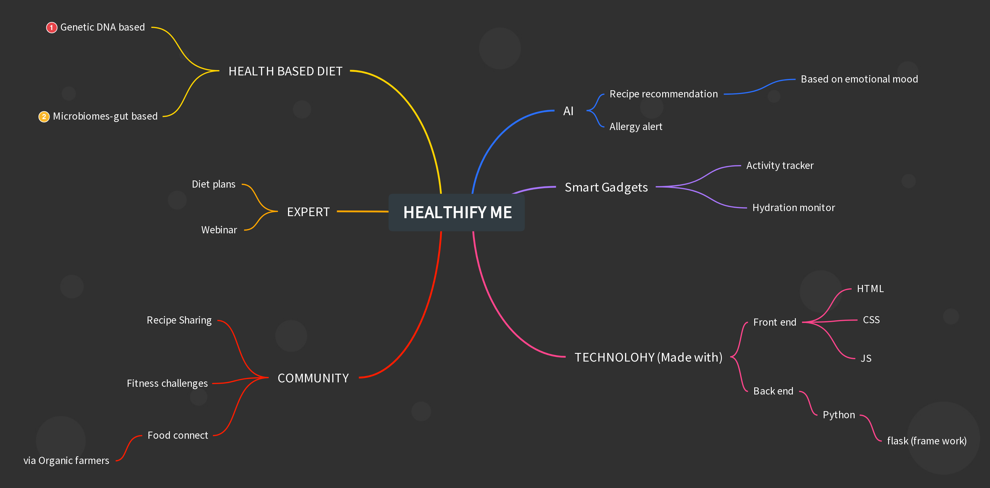

MIND MAP

Slide 8
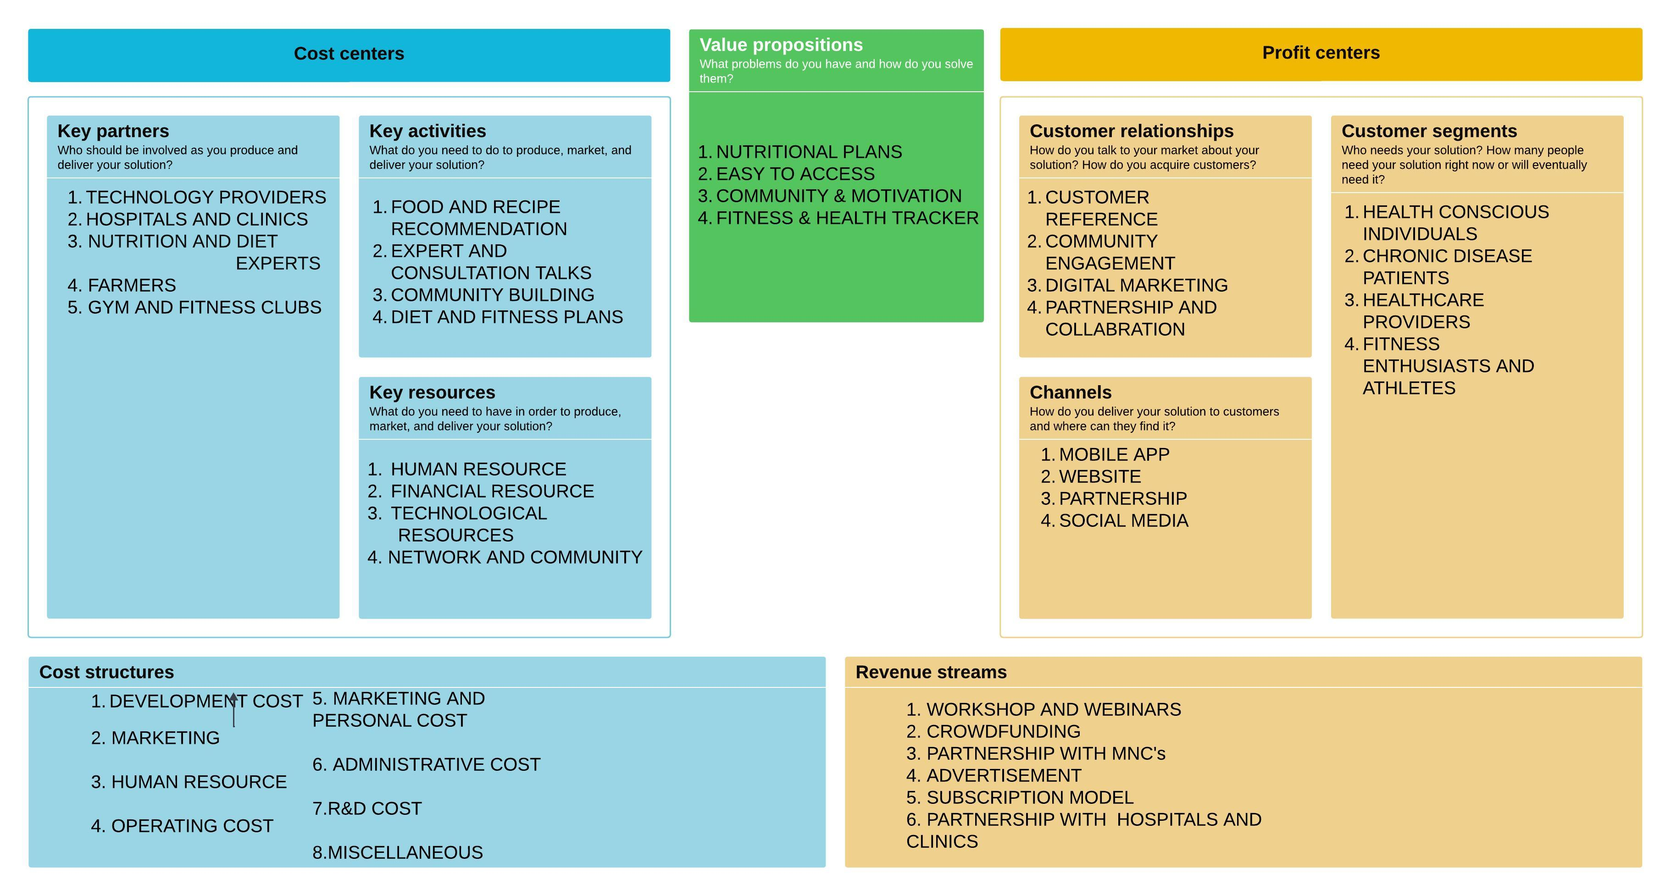
BUSINESS MODEL CANVA

Slide 9
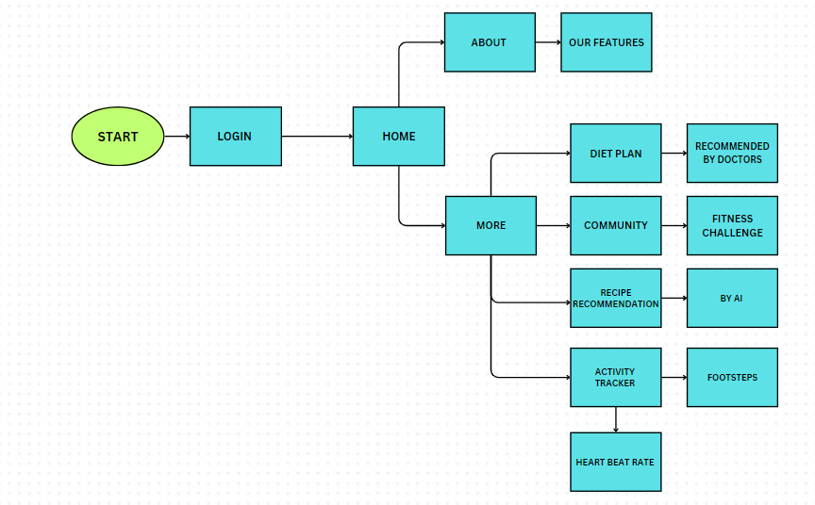
BLOCK DIAGRAM

Slide 10
Our project redefines health and family well-being by offering tailored food recommendations that consider allergens and dietary restrictions for safe and enjoyable meals. We engage families through challenges that promote bonding and healthy habits and provide real-time recipe suggestions that match moods and preferences. With expert-designed diet plans ensuring optimal nutrition, we create a holistic and enriching approach to healthier, happier lives.
CONLUSION

